Slide 1
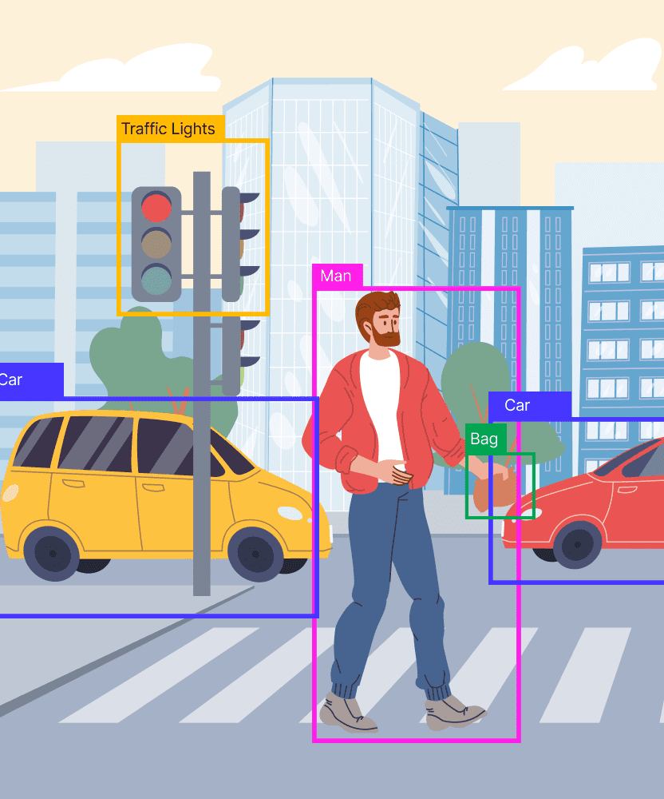
Helmet and Number Plate Detection
Using YOLOv8
Notes:
This project focuses on detecting helmets and license plates using the YOLOv8 object detection model. The aim is to develop a system capable of identifying motorcycle riders wearing helmets and recognizing license plates in real-time videos and images. Leveraging the power of YOLOv8, which stands for "You Only Look Once," the project uses deep learning to accurately detect and classify objects within images at high speed. The dataset is managed using Roboflow, ensuring seamless integration, version control, and optimized training. The detection model is trained and fine-tuned to identify specific objects such as helmets and license plates. The project also integrates Gradio to create a user-friendly interface, allowing users to upload images and view the detection results in real-time. This solution has practical applications in traffic law enforcement, road safety monitoring, and automated surveillance systems.

Slide 2

Introduction
Project Goal:
To detect helmets and number plates using the YOLOv8 model.
Why YOLOv8?
YOLO (You Only Look Once) is a state-of-the-art model for real-time object detection, widely known for its speed and accuracy.
Notes:
YOLOv8 is well-known for its speed and accuracy, making it suitable for real-time object detection.“
YOLO algorithm takes an image as input and then uses a simple deep convolutional neural network to detect objects in the image
This can be useful in road safety monitoring, automated traffic control, and law enforcement.“

Slide 3

Environment Setup
System Configuration:
The NVIDIA GPU which is crucial for efficiently running deep learning models like YOLO.
Example setup:
Tesla T4 GPU on Google Colab.
Helmet and Number Plate Detection
Notes:
Efficient processing and training of models like YOLOv8 require a strong GPU setup.

Slide 4
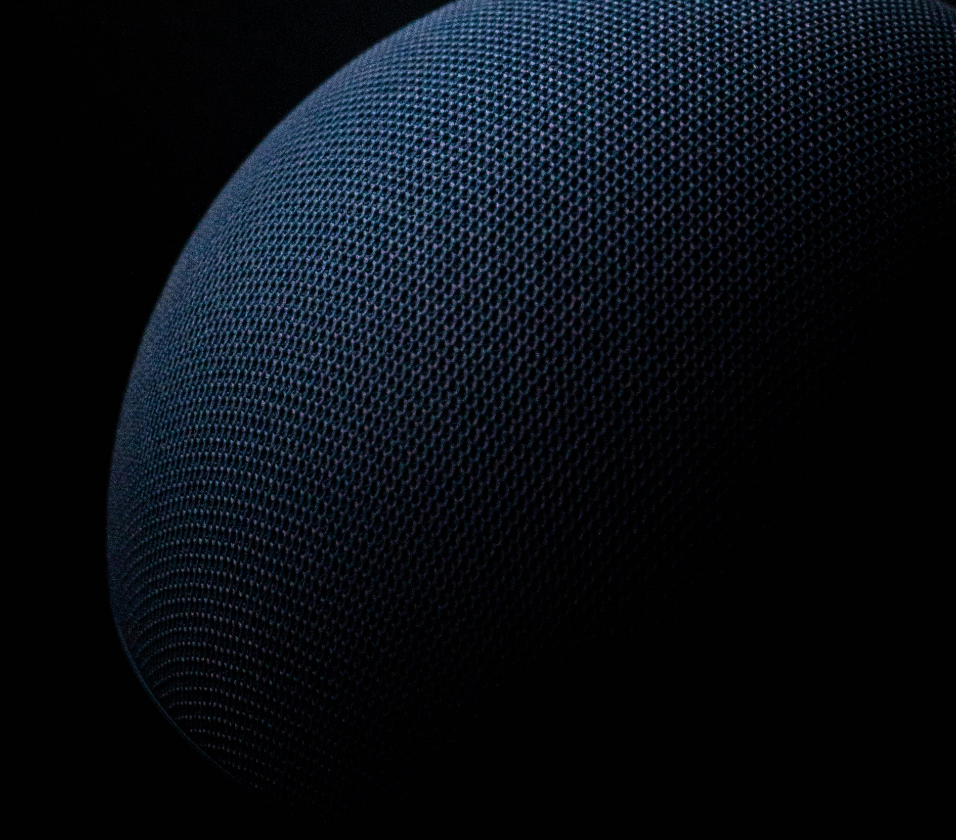

Model Overview
About YOLOv8:
Developed by Ultralytics, YOLOv8 introduces new features and improvements for enhanced performance, flexibility, and efficiency.
Supports multiple vision AI tasks: detection, segmentation, pose estimation, tracking, and classification.
Why Ultralytics?
Mission: Simplifying AI model development and deployment.
Versatility: YOLOv8’s adaptability across various applications and domains.
Helmet and Number Plate Detection
Notes:
YOLOv8 supports tasks like detection, segmentation, pose estimation, tracking, and classification.
This version builds on previous YOLO models with enhanced performance and ease of use.
Ultralytics has designed YOLOv8 to make AI model development more accessible and efficient.

Slide 5

Roboflow Integration
Why Use Roboflow?
What is Roboflow?
Dataset Management: Streamline the process of organizing, labeling, and versioning datasets.
Preprocessing: Automatically handle tasks like resizing, augmentation, and format conversion.
Seamless YOLOv8 Integration: Easily export datasets in YOLOv8 format for quick model training.
How It's Used in This Project: API integration to fetch and download the dataset.
Roboflow is a powerful tool for managing computer vision datasets, training models, and deploying projects.
It simplifies the workflow by providing an interface for labeling, preprocessing, and exporting datasets compatible with various models.
Helmet and Number Plate Detection
Notes:
Roboflow simplifies the management of datasets, from labeling to model deployment.“

Slide 6

Implementation Details
Key Points:
Basic commands:
"Here, we load the YOLOv8 nano model and perform predictions on sample images.“
Emphasize dataset integration with Roboflow.
Training setup:
"We trained the model with 25 epochs and image size of 640x640 for optimal accuracy."
Helmet and Number Plate Detection

Slide 7
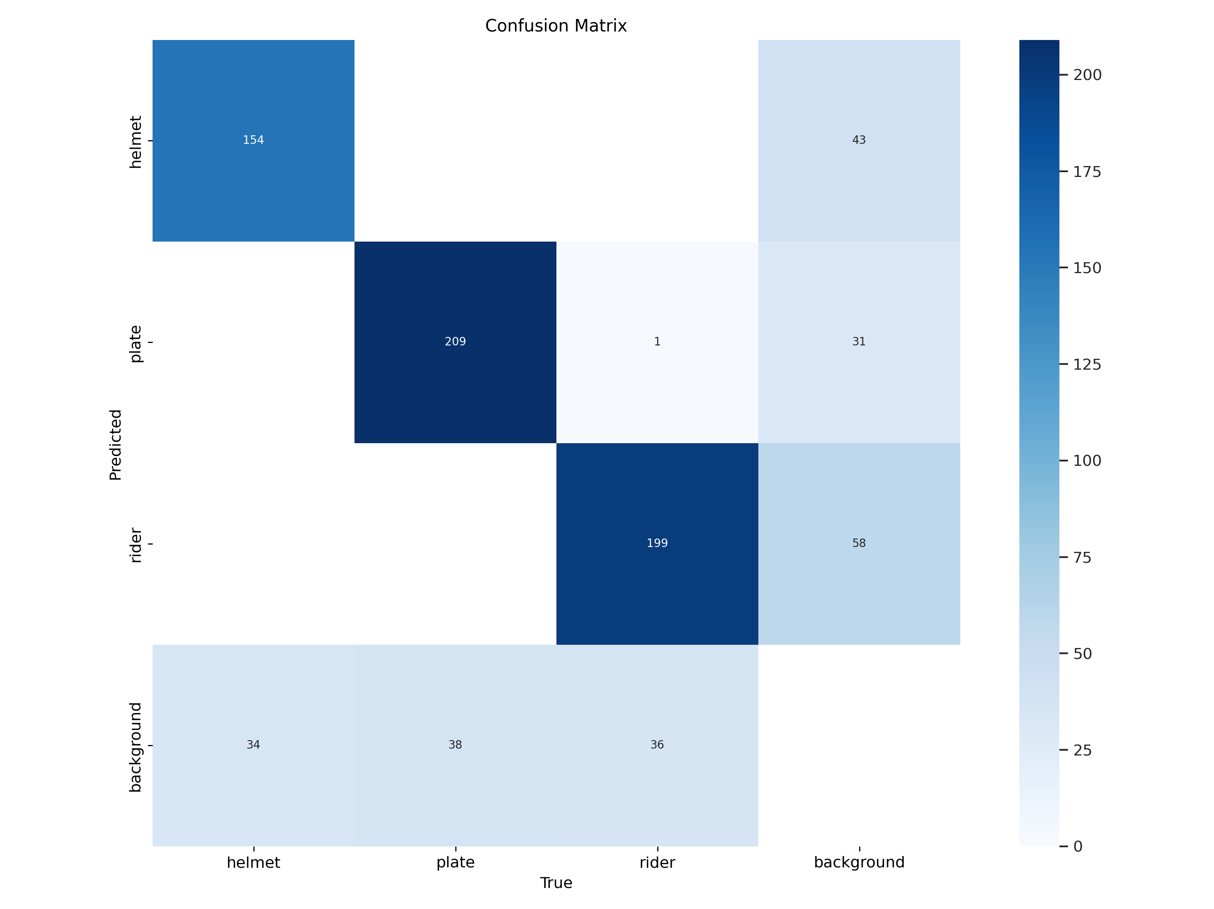
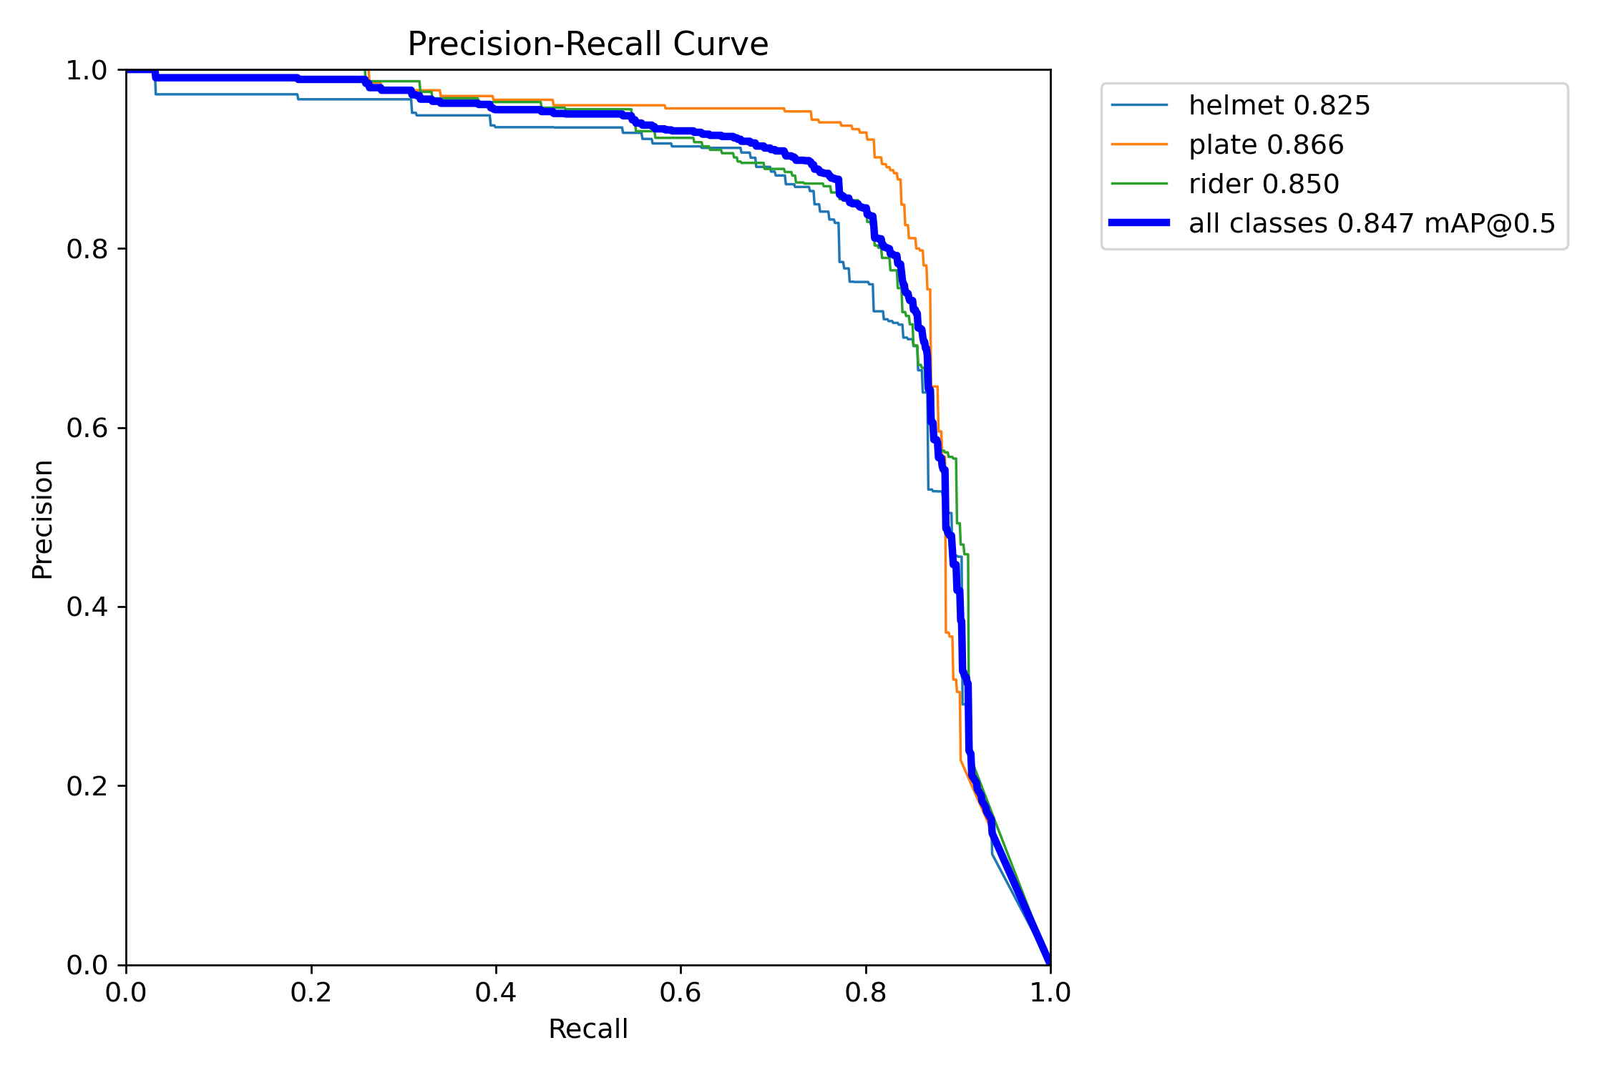
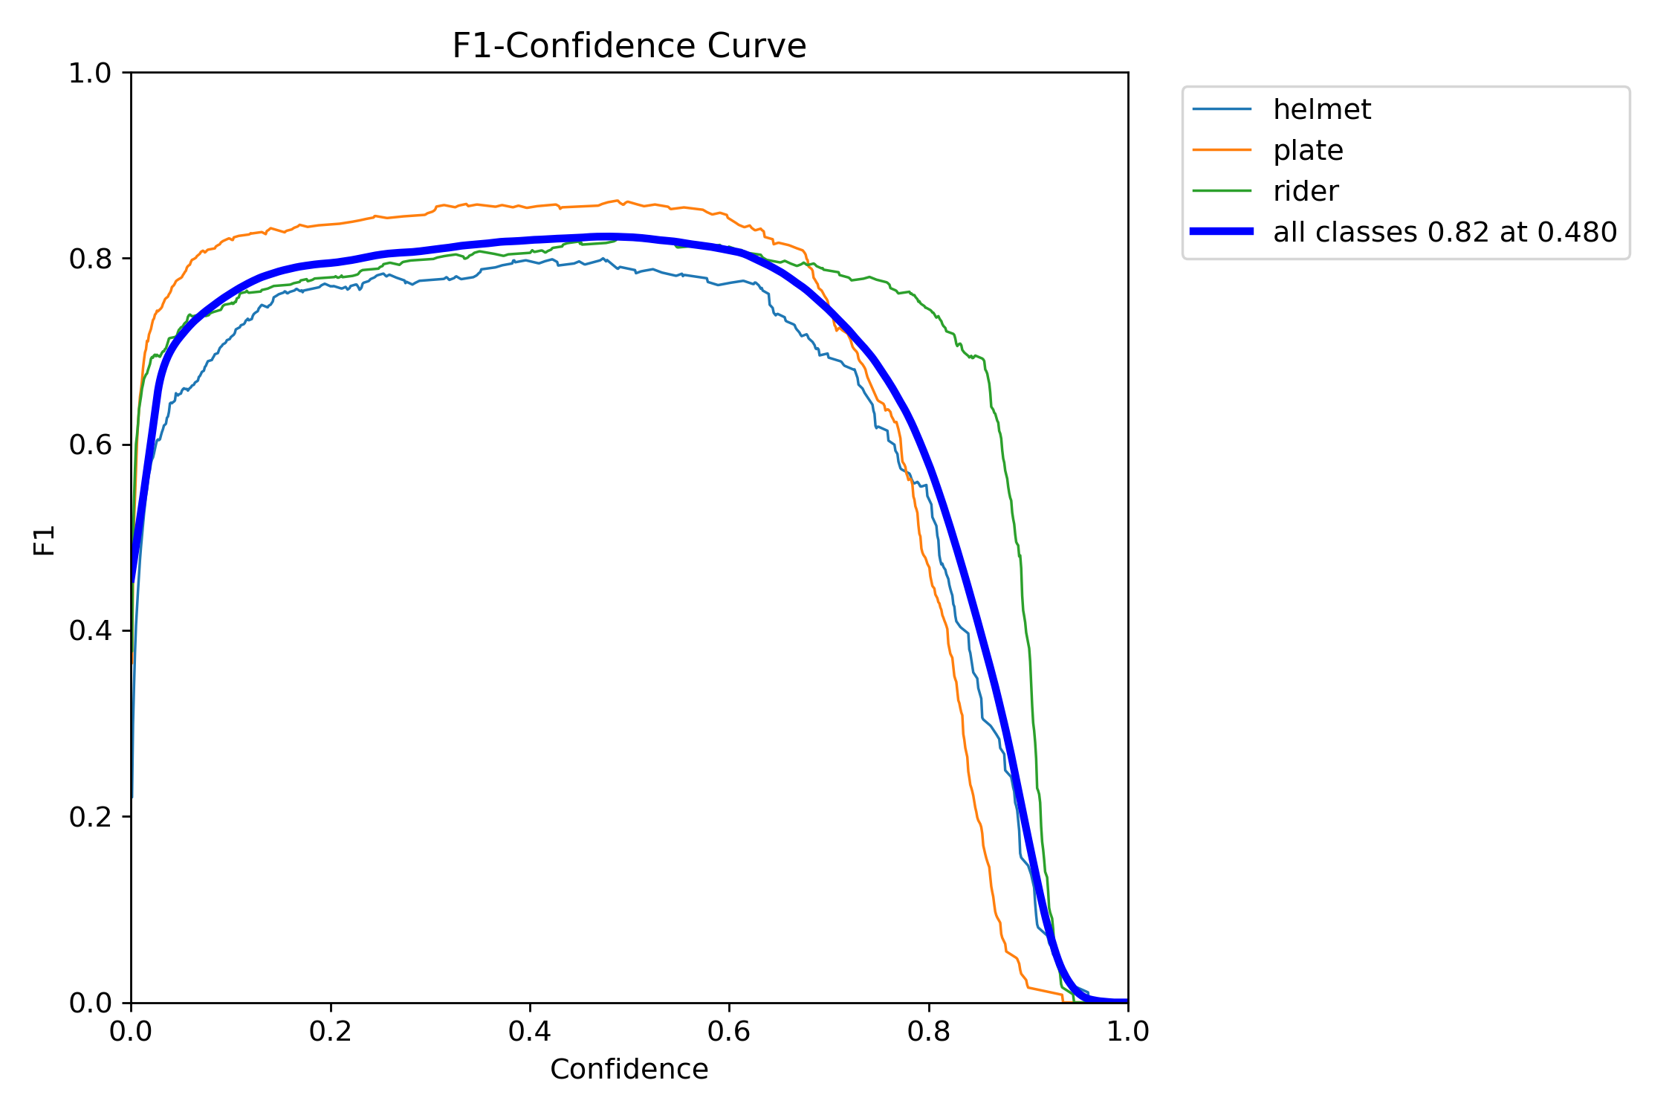
Model Evaluation and Results
Performance Metrics:
F1 Score Curve: Shows confidence vs. F1 score.
PR Curve: Precision-recall performance.
Recall Curve: Sensitivity of the model across classes.
Confusion Matrix: Visualization of classification performance (e.g., correct vs. misclassified predictions).
Sample Predictions: Visualization of predictions on test images.
Confusion Matrix
PR Curve
F1 Score Curve
Helmet and Number Plate Detection

Slide 8

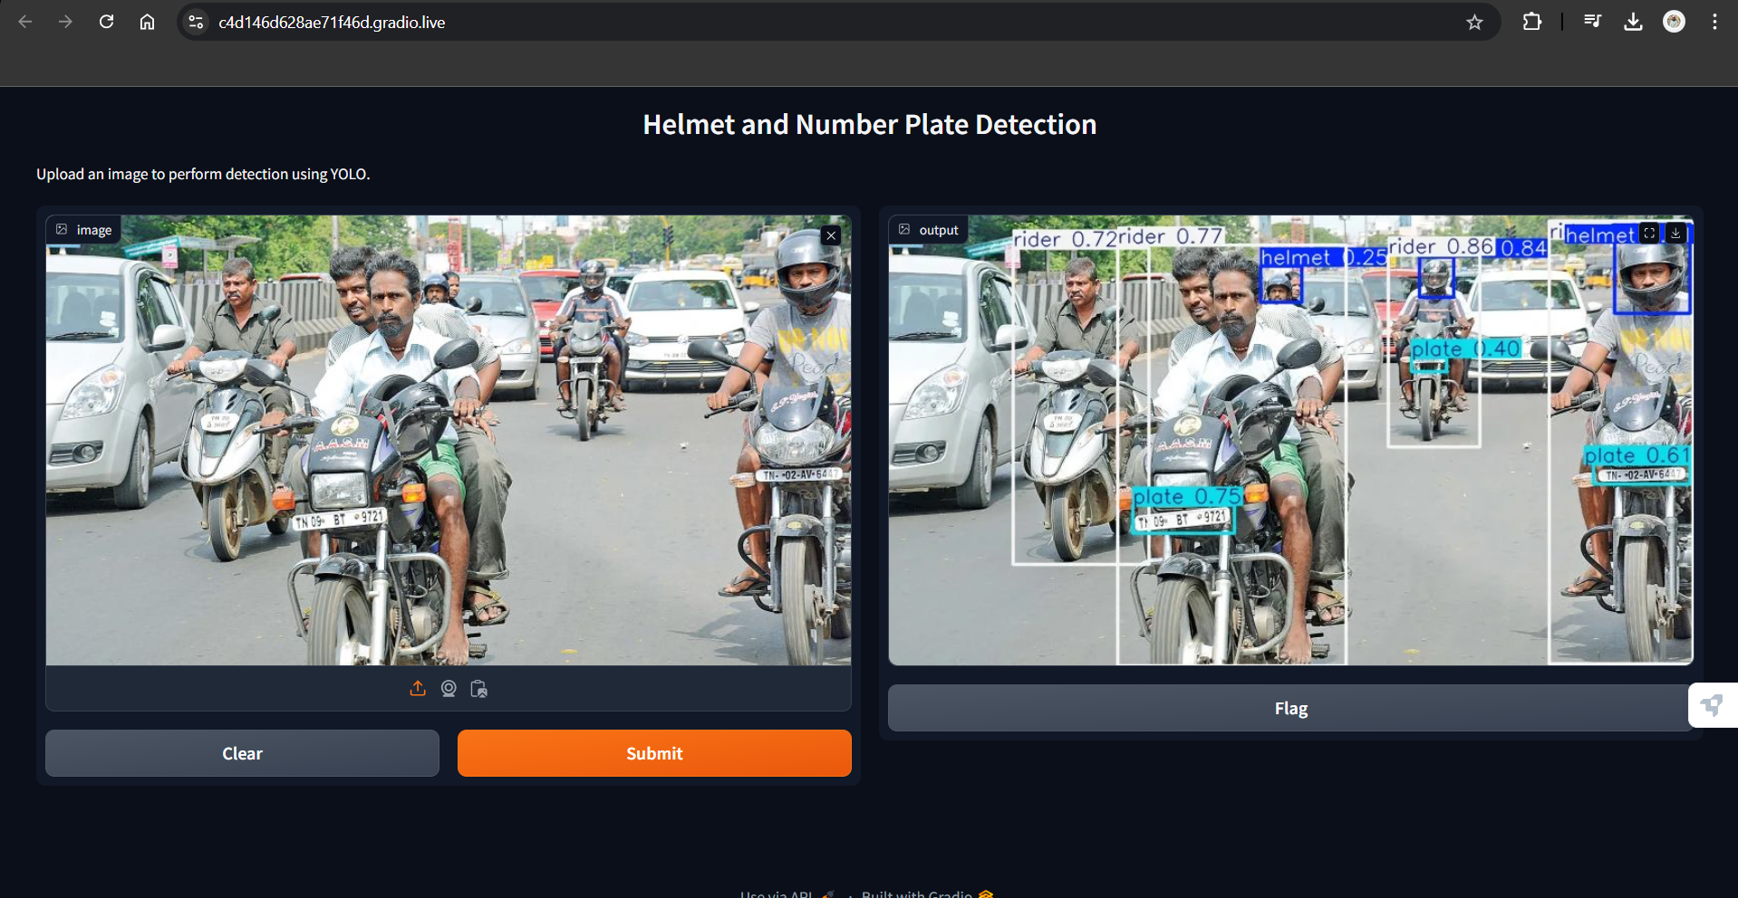
Gradio Interface Setup
Objective:
Create a user-friendly interface for uploading images and receiving predictions.
How it Works:
Users upload images via the interface.YOLOv8 processes the images, and results are displayed instantly.
Helmet and Number Plate Detection

Slide 9
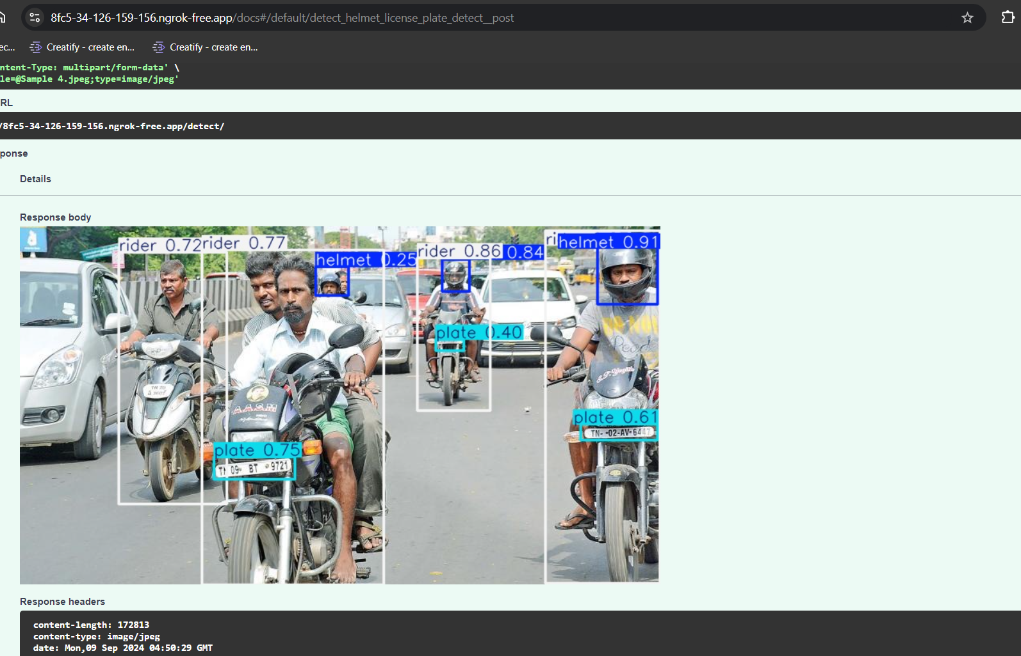
Fast Api Interface Setup
Objective:
Create a user-friendly interface for uploading images and receiving predictions.
How it Works:
Users upload images via the interface.YOLOv8 processes the images, and results are displayed instantly.
Helmet and Number Plate Detection

Slide 10
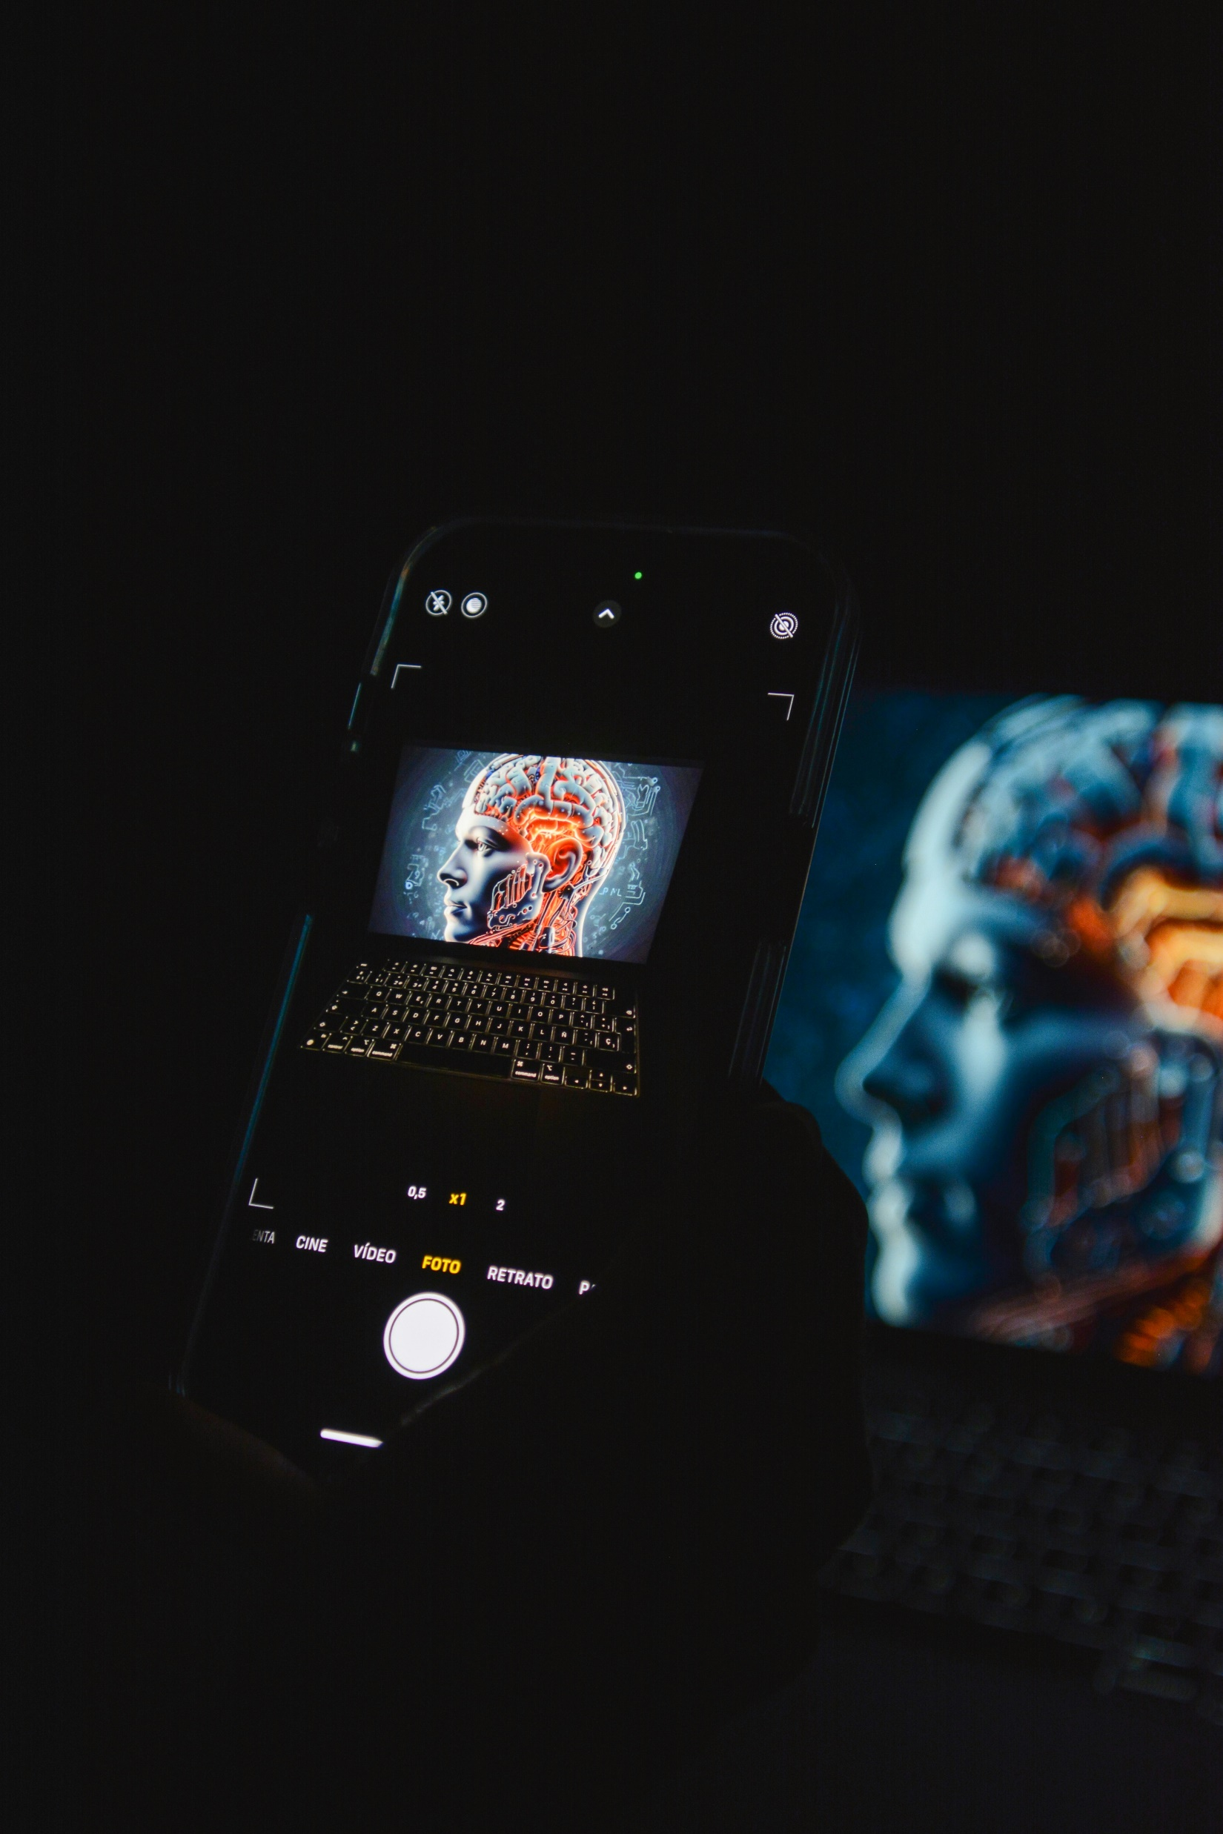
Key Insights and Conclusion
Overall, YOLOv8 provided reliable detection of helmets and number plates with strong accuracy The integration with Gradio and Roboflow made the process smooth and user-friendly. This solution could be integrated into real-world systems for road safety, automated monitoring, and compliance enforcement.
Model Performance:
Ease of Use:
The model provides accurate detection of helmets and number plates, with detailed visualizations to evaluate its performance.
With Gradio, the project becomes accessible to non-technical users, offering real-time interaction with the detection model.
Helmet and Number Plate Detection

Slide 11
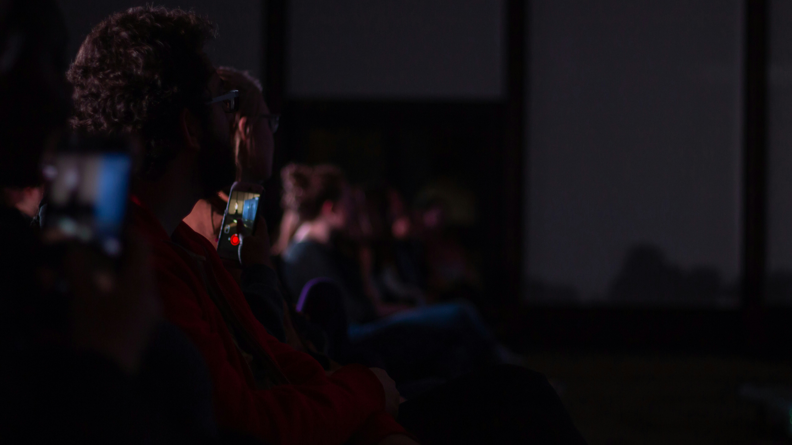
Thanks
Jazak Allah Khair

